Slide 1
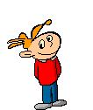
Navigating “No Man’s Land”
Helping Children Survive Family Separation and Divorce
Tracy Duffy, Family Court Counsellor (M. Ed, CCC)

Slide 2
Background
Family Justice Services, NL
Separation and Divorce – context
Defining Conflict

Slide 3
Parent dynamics
Indicators of High Conflict
Communication Conflict

Slide 4


Games Parents Play
Messenger
Spy
Critic
Disneyland
The Pawn
The Set up

Slide 5
“It is far easier to build strong children than to repair broken adults.”
- Frederick Douglas

Slide 6

Activity
Notes:
Pause for a moment to change our mindsets – the child is always the client

Slide 7

Children’s Reactions- Impact of divorce
Considerations
“Normal” grief
Developmental impacts
Traumatic Adjustment
(No Man’s Land)

Slide 8
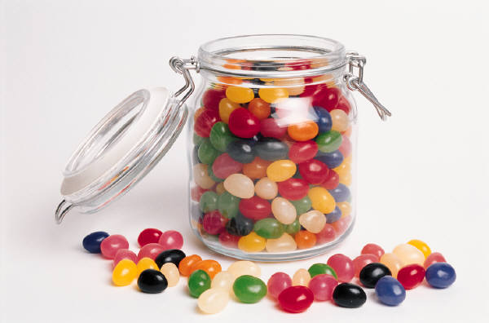
Interventions with children
Play Therapy
Feelings Jar
Collage
Case Examples

Slide 9
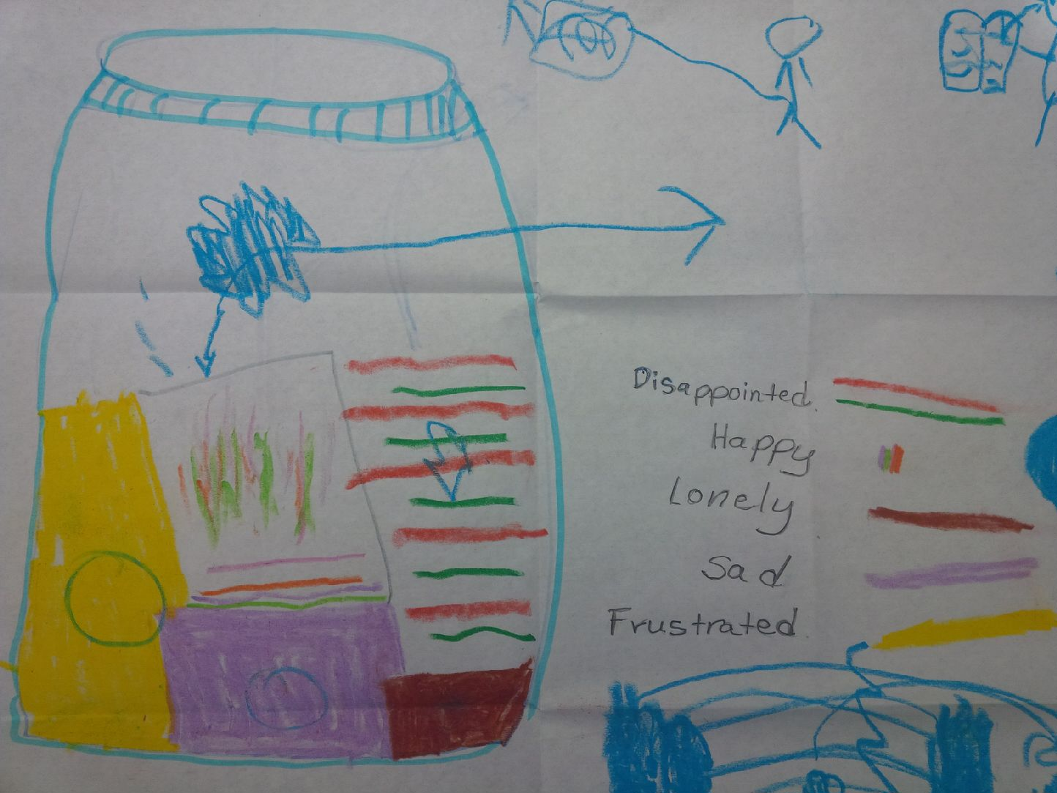

Slide 10
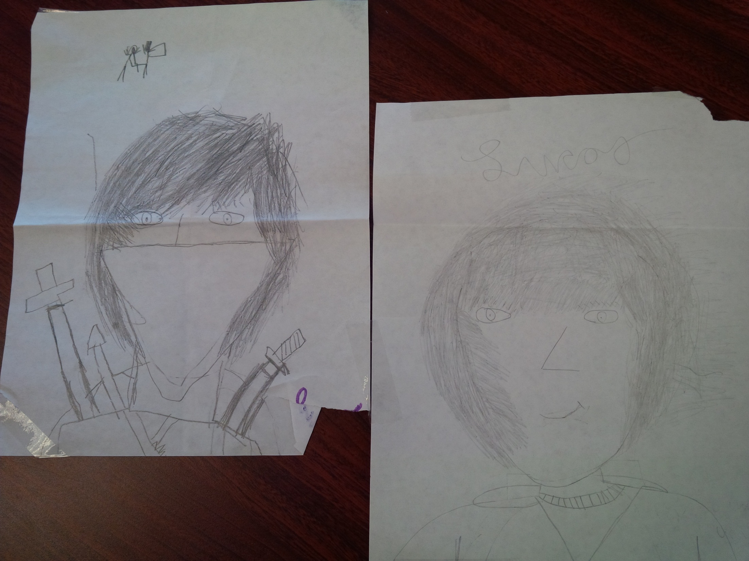

Slide 11
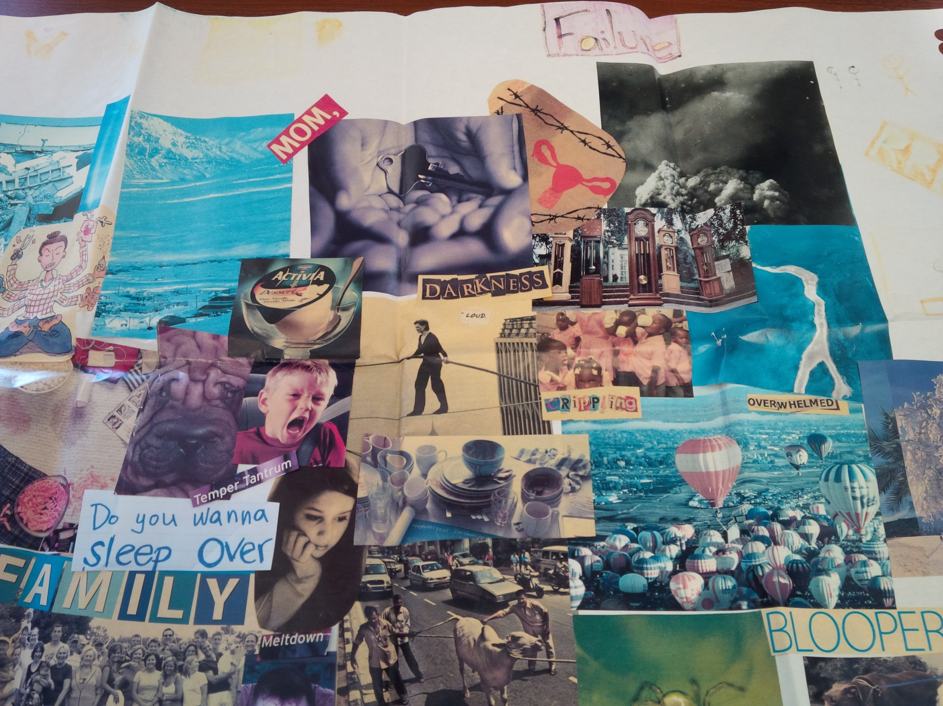

Slide 12

Role of Counsellor
Considerations
Cautions – Ethics
Who is the client ?
33

Slide 13

Resources
Play Therapy
Separation/Divorce

