Slide 1
CCPA 2014 - Victoria
Career Preparation:
Shortcut to Success and Prosperity
Phil Jarvis, Career Cruising

Slide 2
North America
Notes:
Founders graduated from university and realized they still had to figure out what they wanted to do with their lives.
Uncovered a passion to help students to chart their future paths so they could get the most out of school, their careers and life.
PROVEN - in over 20,000 schools. we support more students, parents, and educators than any other career development tool in North America
ACTIVE - and vibrant online community, with over 5 million page views per day.

Slide 3
Canada
75% of Canada’s secondary and post-secondary schools,
employment support centres and public libraries
Used more than all other career and LMI sites combined
(2012/13 CCDF research on Impact of LMI funded by HRSDC)
Notes:
Founders graduated from university and realized they still had to figure out what they wanted to do with their lives.
Uncovered a passion to help students to chart their future paths so they could get the most out of school, their careers and life.
PROVEN - in over 20,000 schools. we support more students, parents, and educators than any other career development tool in North America
ACTIVE - and vibrant online community, with over 5 million page views per day.

Slide 4
Our Mission
“To engage and inspire individuals of all ages to achieve their full potential in school, career and life.”
Notes:
Our Mission here at Career Cruising is straightforward.
It drives everything we develop. You will also experience our commitment to you and your students when you interact with our staff.
State the mission out loud.
TIP: In preparation for the presentation, visit the school’s website. If there mission is posted, it is a good place to reference their mission, point out how they are similar or how the Career Cruising mission can support their mission or initiatives that you saw on their site.

Slide 5
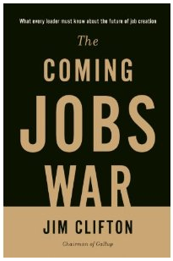
The Gallup World Poll was started in 2005, covers virtually every demographic and socioeconomic group in every country in the world, and will go on for 100 years.
Biggest discovery so far:
More than anything else, the whole world wants
a good job!
Communities that provide their citizens good jobs and their employers
engaged employees will the winners in The Coming Jobs War.
Notes:
Politicians around the world will increasingly focus on providing good jobs for their constituents as their top priority. The education system is going to have to re-orient itself to the primary goal of preparing students to graduate seamlessly into good jobs.

Slide 6
Talent Pipeline
Notes:
Megatrend 4: Unprepared Workforce
In raw numbers, the biggest workforce challenge is upgrading the skills of current workers and adult job seekers. Few employers are investing adequately in employee career management and training. Workers themselves are not investing adequately in upgrading their skills. If their employer provides inadequate skills upgrading opportunities, few can quit work for an extended period to upgrade their skills.
If we focus on youth now in the educational pipeline, we will see in the next few slides that we are failing a majority students who believe what they have been told by their parents and educators, that a good education will assure good career prospects.

Slide 7
Leaky Pipeline
National HS graduation rate 81% (OECD, 2012)
60% of HS grads (49%) register immediately for post-secondary programs
25% of post-secondary students drop out and a further 27% change programs by the end of the first year.
56% of the HS grads who register immediately for PS programs eventually graduate (27 out of 100).
OECD, 2012
King, 2009, Who Doesn’t Go To Post-Secondary Education?
Education Indicators 2012, Statistics Canada & Council of Ministers of Education Canada
Miner, 2014, The Great Canadian Skills Mismatch: People Without Jobs, Jobs Without People and MORE
Notes:
60% of HS grads (47%) register immediately for post-secondary programs (King, 2009, Who Doesn’t Go To Post-Secondary Education?)
25% of post-secondary students dropout by the end of the first year. A similar percent change programs or majors (Miner, 2010, People Without Jobs, Jobs Without People)

Slide 8
End of the Pipeline
100 Grade 9 Students: <30 will graduate on schedule with post-secondary degree, diploma, certificate
14-20% youth unemployment (Statistics Canada)
39% mal-employed or underemployed (Sun Life Financial Canada Poll of 18-24 year olds, November, 2012)
90% of Youth 18-24 feel Excessive Stress. Why? Economic instability and underemployment (Sun Life Financial Canada, Nov 2012)
2013 summer jobs at lowest level since 1977 (C.D. Howe Institute)
“The linear path from school to career, home ownership, and family has disappeared.”
Community Foundations of Canada, October 2012
Notes:
Of 100 students in the educational pipeline in grade 9 each year …
29 will graduate on schedule with a post-secondary degree, diploma or certificate
50% will not be in jobs directly related to their majors 2 years after graduation (Statistics Canada and Human Resources & Skills Development Canada, School Leavers Survey) – “Mal-employed”
By 2031 about 77% of the workforce will require a post-secondary education or training (Jobs of the Future: Options and Opportunities, Rick Miner, PhD, March 2012)
Many carry heavy student loan debt with unclear employment prospects and career goals
Few educational institutions consider helping students imagine and prepare for successful employment trajectories beyond education among their responsibilities. Many perpetuate what has become a broken promise that university will guarantee substantially more income and a better life than “lesser” educational and training alternatives. Yet, the majority of today’s youth exit the educational system into unemployment, underemployment, or mal-employment, often mired in student loan debt and confusion about immediate career prospects. Too many students, even those with university degrees, begin their careers in minimum wage jobs unrelated to their studies, with little prospect of paying off their student loans let alone buying a car and home and beginning a fulfilling adult life.
Given the coming exodus of high-end talent boomers will take with them into retirement, and the increasingly inadequate supply of young talent, ensuring youth exit the educational pipeline into early career success has become an economic and social imperative.
Today’s students need higher skill levels than any cohort before them. Yet, key 21st century “essential” skills employers now insist upon are not in core curriculum in most secondary and postsecondary programs. Many students fail to see personal relevance in traditional academic curricula, thus they are not fully engaged in their learning and are underachieving.

Slide 9
Admission to a Good Life
By 2031 approximately 77% of the workforce will require a post-secondary education or training
Jobs of the Future: Options and Opportunities, Rick Miner, PhD, March 2012)
“Over the past third of a century all net job growth has been generated by positions requiring some
post-secondary education.”
Pathways to Prosperity, 2011, Harvard Graduate School of Education
Notes:
Pathways to Prosperity, from the Harvard Graduate School of Education is a comprehensive picture of the process of transitioning education to life in contemporary America. Among its many profound findings is the quote on the screen. Growth has only been occurring since the early 1980’s in jobs requiring at least some level of post-secondary education. Yes, it is still possible to get a job with a high school education of less, but there prospect are diminishing in a workforce characterized by accelerating technological innovation.
So, all opportunity growth is occurring in jobs requiring postsecondary education (i.e., trades certifications, apprenticeship, college, university). Yet, at present 29 percent of students are exiting the educational system on time with some level of postsecondary certification. We are setting up the vast majority of youth for a rocky initial stage of the career journey.

Slide 10
Generation Nixed
Notes:
We have broken our promise to young people. Educators have led young people to believe that the farther they go with their education, the brighter their future prospects. Trade and vocational options have been seen as lesser, fallback learning options for those not capable of pursuing university studies. Students have heard claims the those with university degrees will make $1 million more over the span of their careers than high school graduates. Parents have perpetuated the myth, encouraging their children to go to university if they are capable. Academic curriculum in public school is based on university entrance requirements.
The reality is that the majority of university graduates are now unemployed, underemployed or mal-employed after they graduate, often mired in student loan debt, making minimum wages, unclear of their employment prospects, and unable to move out of their parental home. Increasing numbers of university graduates are returning to community college to acquire credentials employers are seeking.
Apparently sitting in a classroom of 500 students listening to someone at a podium is not providing the 21st century skills employers are seeking.

Slide 11
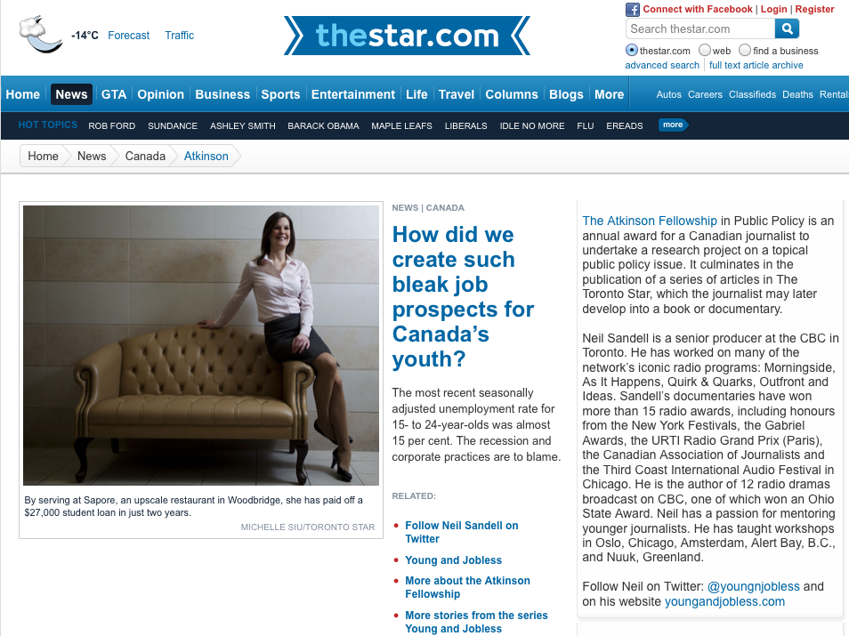
Young & Jobless Series
Notes:
Excerpt from “How did we create such bleak prospects for Canada’s youth? Neil Sandell, Toronto Star, November 30, 2012.
…. “An undergraduate degree has become the new high school diploma. What has happened is that the well educated are pushing 15- to 19-year-olds out of jobs.
Meanwhile, the underemployed university grads represent a squandering of money — theirs, their parents’, that of the public purse. Weighed down by student debt, they bide their time at jobs with no connection to their training. Their skills grow rusty. As time passes, employers stigmatize them. When a decent job does come up, the freshly minted graduate has the edge.
There is ample evidence that the underemployed suffer long-term reduced earnings. In the meantime, jobs in some sections of the economy go begging because of a shortage of people with the right skills. …”

Slide 12
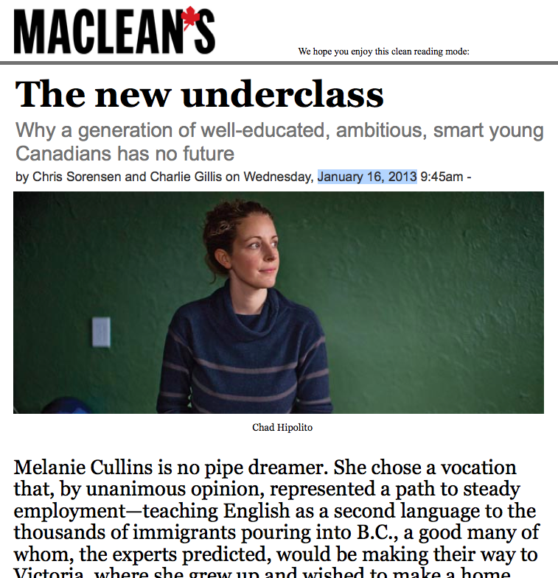
Generation with no Future
Notes:
Employers can’t find people with the skills they need, even among recent university graduates. The recent student unrest in Quebec will spill into other jurisdictions if universities and colleges continue to raise there tuitions without committing to equipping students with the 21st century skills and competencies they need for immediate career success when they graduate.

Slide 13
CBC Documentary
CBC TELEVISION’S DOC ZONE
Jan 31st/Aug 23rd, 2013

Slide 14
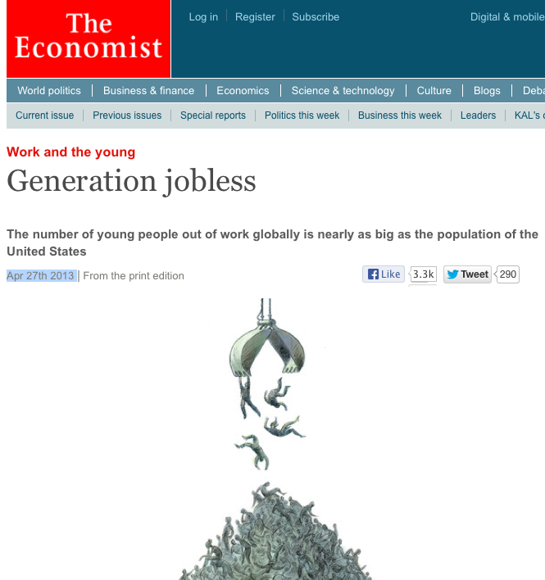
Generation Jobless
“The problem of youth unemployment has been getting worse for several years. But there are at last some reasons for hope. Governments are trying to address the mismatch between education and the labour market. Companies are beginning to take more responsibility for investing in the young. And technology is helping democratise education and training. The world has a real chance of introducing an education-and-training revolution worthy of the scale of the problem.”

Slide 15
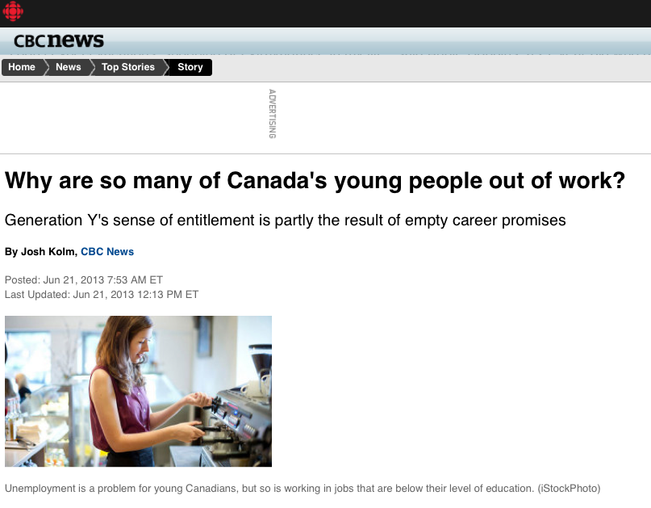
Entitlement?

Slide 16
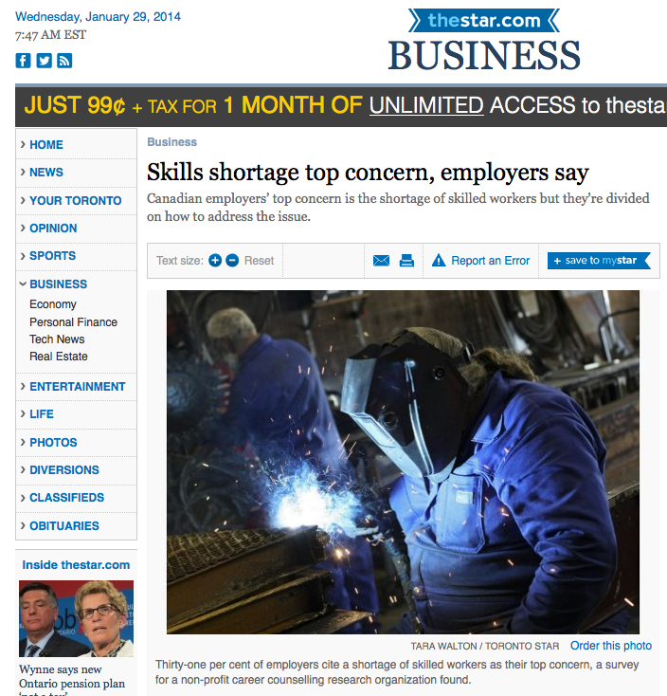
Skills Shortage

Slide 17
Employee Engagement
28% of workers are fully engaged
About the same number are actively disengaged
The rest are doing just what they have to
Low employee engagement costs the US $37B/yr
Gallup, Inc., 2013
(50,000 work units, 1.5 million employees, 49 industries, 34 countries)

Slide 18
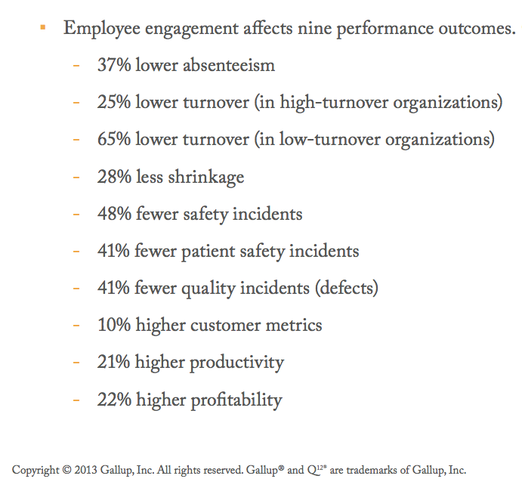
Employee Engagement
Top quartile vs bottom quartile

Slide 19
Economic Consequences
Productivity $ 1.3 Trillion
Health $122 Billion
Education $100 Billion
Social Services $190 Billion
Policing & Prisons $ 51 Billion
Govt Revenues $585 Billion
1% Difference = $17 Billion (Annually)

Slide 20
Human Consequences
Individuals
Families
Communities
Regions
Nation
The “Ripple Effect”

Slide 21
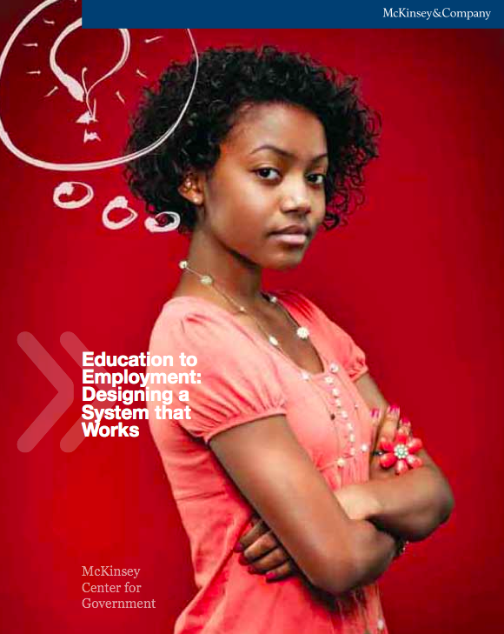
Designing a System That Works

Slide 22
Transforming Education

Slide 23
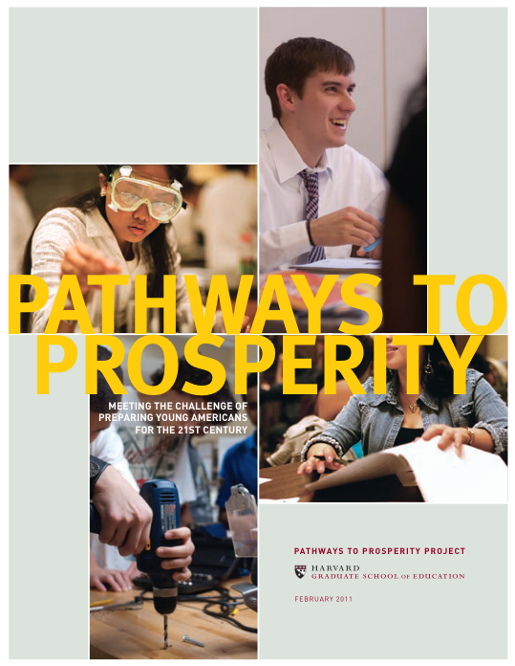
Harvard’s Pathways Movement

Slide 24
Consensus
Educators and employers must collaborate to provide work-based and project-based learning opportunities for secondary and post-secondary students.
Career guidance must be enhanced so students choose pathways based on their unique interests, talents, and aspirations, and on contemporary workforce needs.
All learning pathways to career roles in demand in the workforce deserve equal priority and respect.
The contributions of educators, parents, employers, and community agencies are all vital and must be harmonized.

Slide 25
The Gallup World Poll was started in 2005, covers virtually every demographic and socioeconomic group in every country in the world, and will go on for 100 years.
Biggest discovery so far:
More than anything else, the whole world wants
a good job!
Communities that provide their citizens good jobs and their employers
engaged employees will the winners in The Coming Jobs War.
Notes:
Politicians around the world will increasingly focus on providing good jobs for their constituents as their top priority. The education system is going to have to re-orient itself to the primary goal of preparing students to graduate seamlessly into good jobs.

Slide 26
Sounds Good, But How?
How can we harmonize the efforts of students,
educators, parents, adult career seekers, career practitioners, employers, community leaders and partners – i.e., the whole community?

Slide 27
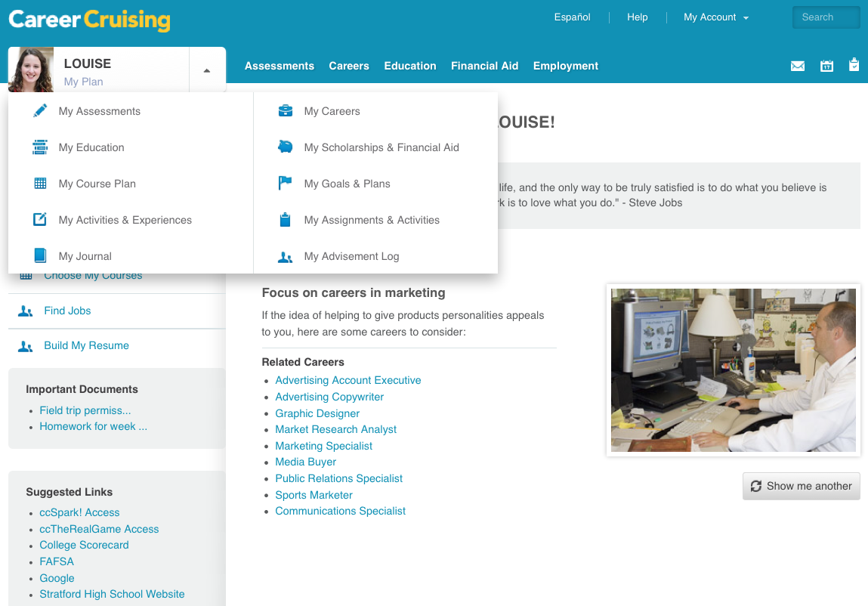
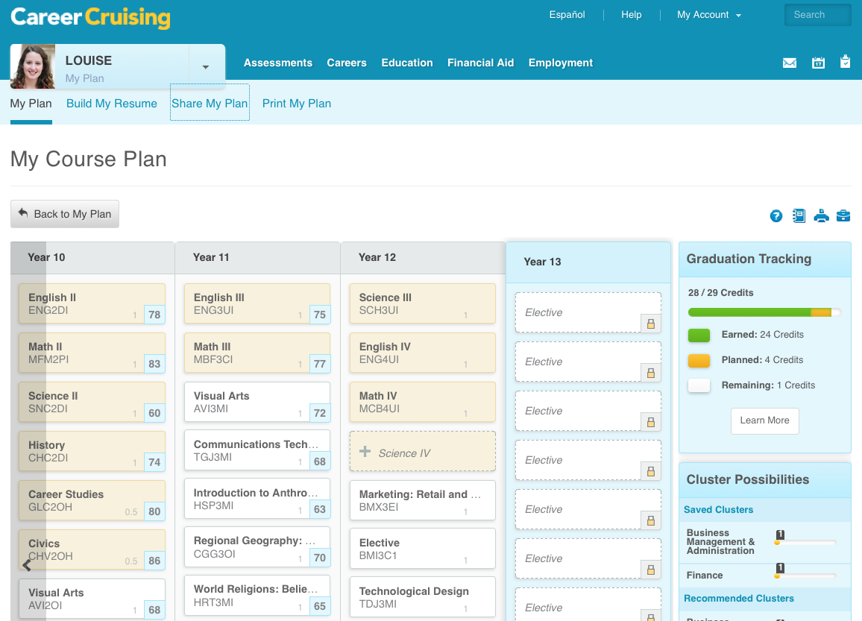
Careercruising.com

