Slide 1
Emotional Intelligence Training Program for At-Risk Youth in High School
Shelley Skelton
2013

Slide 2
Presentation Format
Introduction to Emotional Intelligence
Rationale to use this program in schools
Review of the program
Practical information about program implementation
Questions and discussion

Slide 3

What emotions have you experienced in the past 24 hours?

Slide 4
Compare situations in which you react to those in which you respond.

Slide 5
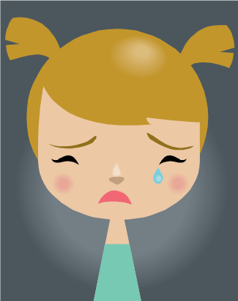
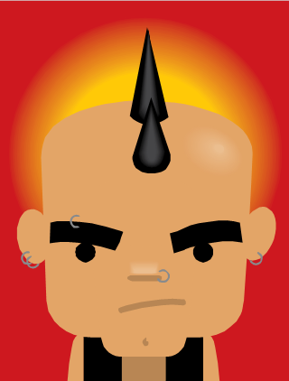
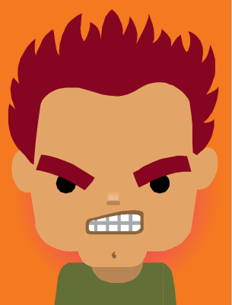
What emotions do you experience most often and how do you express them?

Slide 6
What triggers your emotional reactions?
People?
Places?
Times?
Words?

Slide 7
What is emotional Intelligence?
Self-awareness & developing a positive sense of self-worth
Problem-solving
Emotional management / Impulse control
Decision-making
Relationship-building / Empathy / Social Skills
Taking responsibility for one’s actions

Slide 8
What is the connection?
At-risk youth Low EI
Unsuccessful in school
Disengaged
Disconnected from teachers & peers
Poorly developed sense of identity
Struggle with relationships
Negative attitudes
Inexpressive

Slide 9
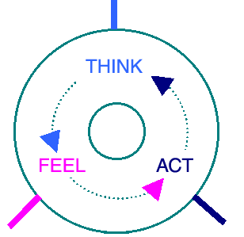
What is the connection?
http://www.lifetrack.com/lifetrack/en/concepts/turning_mindwheel.jsp

Slide 10
E I Training Program
Level I Self-awareness
Level II Emotion Management
Level III Relationship Building

Slide 11
Level I: Self-awareness
1. How the brain works
2. Identification of emotions
3. Emotional triggers
4. Positive self-regard
5. Application of personal awareness

Slide 12
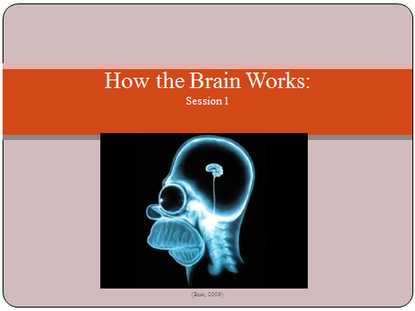

Slide 13
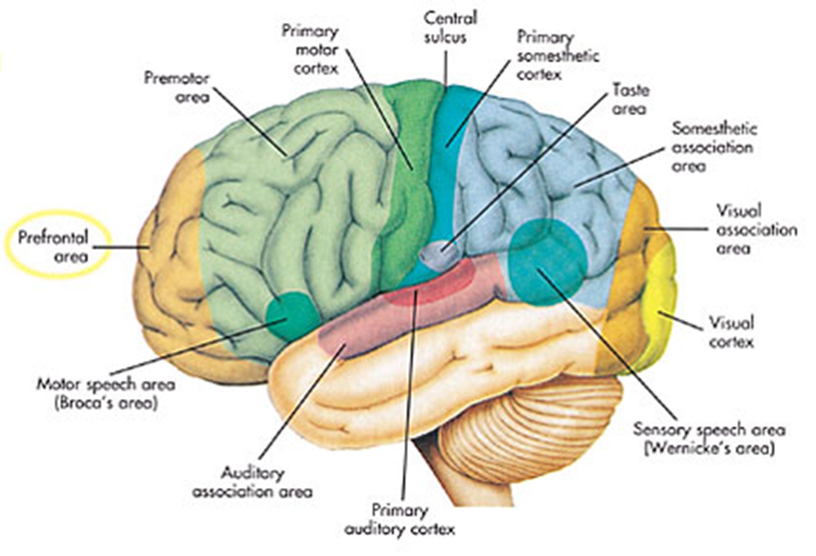
Cerebral Cortex:
Complex Thought

Slide 14
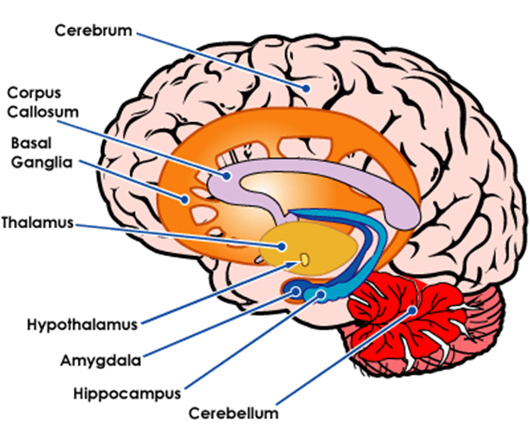
Limbic System: Emotions
Hippocampus: emotions & memory
Amygdala: emotional control & fear control
Hypothalamus: regulates fear & aggression

Slide 15
The Amygdala
Reptilian brain
Fight or flight responses.
Gate keeper of the brain, judging each new sensation to be a threat or safe.
When senses danger, sends out an alarm puttingthe entire body on alert.

Slide 16
Emotional Hijacking
We feel before we think; everything that we sense has already been filtered through our emotional brain.
When danger is sensed, we react emotionally first before the information has reached any part of the cerebral cortex that allows us to process and think rationally
When what we sense reminds us of a past threat, we react with the same intense emotions; we may not even be aware of the memory that has been triggered.

Slide 17
Withstanding the Hijack
In order to think rationally and respond rather than react emotionally, we can need to allow the information to reach the rest of the brain.
We can do this by becoming aware of our emotional triggers and learning to take a moment before reacting.
These skills are key components of Emotional Intelligence.

Slide 18
References
Bear, M. (2009). Homerbrain. Retrieved April 10, 2010, from http://talentedapps.files.wordpress.com/2009/03.
Bionoid (2008). Limbic system. Retrieved April 10, 2010, from http://bionoid.net/images/research/limbic.system.gif.
Broderic, P., & Blewitt, P. (2010). The life span: Human development for helping professionals (3rd ed.). Boston: Pearson.
Goleman, D. (2005). Emotional intelligence: Why it can matter more than IQ. New York: Bantam Books.
Seeley, (2010). Cerbral cortex. Retrieved April 10,2010, from http://theunjustmedia.com/Islam/Science/ch1-1-d-img/jpg.

Slide 19
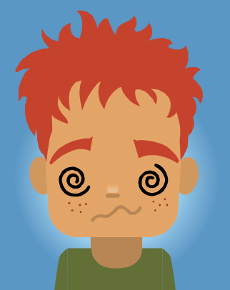

Emotions
Session 2

Slide 20
Coping with Emotions
We typically deal with emotions one of four ways:
1) exaggerating the emotion so that we are overwhelmed by them and lose control;
2) accepting the emotion and not try to regain control;
3) substituting the emotion with something more comfortable like distractions; or
4) managing the emotion through self-awareness.

Slide 21
Seven Basic Emotions
Anger
Happiness
Fear
Disgust
Surprise
Love
Sadness

Slide 22
Which emotions do you feel most often ?
  % of the day why?
Anger
Happiness
Fear
Disgust
Surprise
Love
Sadness

Slide 23

Anger
Blood rushes to our hands so we can fight.
It can be an expression of frustration, stress, anxiety, loss, confusion, embarrassment, jealousy, rejection, threat, etc.
It is one of the most dangerous emotions because it is energizing, and the more often we are angry, the less arousal we need to stay in this state. Anger builds momentum.

Slide 24

Fear
Blood rushes to our arms and legs so we can run or fight.
It immobilizes us and forces us into fright, flight or freeze.
It is connected to worry, anxiety, stress, nervousness, panic, paranoia, and phobias.
It is sometimes expressed as anger.

Slide 25

Sadness
Metabolism slows, giving us time to mourn.
It comes from not getting what you want or a fear of what might happen.
When sad, many people try to isolate themselves, but this cuts us off from resources to get over the sadness.
It is connected to depression, shame, disappointment, regret, guilt, embarrassment, and insecurity.

Slide 26
References
Burande, A. (2010). List of human emotions. Retrieved April 13, 2010, from http://buzzle.com/articles/list-of-human-emotions.html.
Goleman, D. (2005). Emotional intelligence: Why it can matter more than IQ. New York: Bantam Books.
Microsoft Office Word (2007). Anger. Retrieved April 10, 2010, from clipart.
Microsoft Office Word (2007). Fear. Retrieved April 10, 2010, from clipart.
Microsoft Office Word (2007). Sadness. Retrieved April 10, 2010, from clipart.

Slide 27
Level II: Emotion Management
1. Impulse control
2. Stress management
3. Anger management
4. Managing sadness
5. Problem-solving

Slide 28
Level II Summary
Emotional management is about how our thoughts, feelings and behaviours impact one another
We can not control our emotions, but with awareness, we can decide how long we experience them and how much they can impact our actions.
Level II addresses:
Impulse control Anger management
Depressive thinking Stress management

Slide 29
Impulse Control
responding instead of reacting
recognizing the trigger and the physiological reaction and then finding a way to control your response

Slide 30
Anger Management
Anger can have the snowball effect because it can gain momentum from small triggers and when one has an existing level of anger.
Venting often does not get it out of your system; instead it gets stronger.
Managing anger could mean focusing on an incompatible (opposite emotion), using relaxation techniques, or using an awareness of triggers as a cue to walk away.

Slide 31
Level III : Relationship Building
Active listening
Empathy
Awareness of others’ feelings
Open topics and conclusion

Slide 32
Depressive Thinking
Sadness is the emotion that people try to avoid the most.
People often isolate themselves when sad, which disconnects them from supports.
Laughter, exercise, small successes, and helping others can all help in counteracting sadness.
We often feel sad when we hold on to hurt feelings rather than expressing them.

Slide 33
Stress Management
Indicators of stress include: neck and back pain, headaches, overreaction, and change in sleep or appetite.
Worrying plays a part in stress and anxiety. It can create a cycle of negative thinking.
One major source of stress is how we perceive things.
Ways of coping with stress, relaxation techniques, proper nutrition, exercise and sleep.

Slide 34
References
Goleman, D. (2005). Emotional intelligence: Why it matters more than IQ. New York: Bantam Books.
Institute for Health and Human Potential (2005). Mindful morning notes: A path to emotional intelligence. Author: Wayne, Illinois.
Stein, H., & Book, H.(2006). The EQ edge: Emotional intelligence and your success. Mississauga, ON: John Wiley & Sons, Canada.

Slide 35
Practicalities of the Program
Recruitement
Advertising
Food
Time
Parent Involvement
Location

Slide 36

Questions

