Slide 1
Technology in Counselling: Inevitable, Predictable and Ethical
Dr. Paul A Jerry
Associate Professor and Program Director
Graduate Centre for Applied Psychology
Athabasca University
CCPA Victoria 2014

Slide 2
In our very short time together, please remember these three things from me:
1. The integration of technology into our lives and into our professional practices as counsellors is predictable
2. Our reaction to this integration, and our professional competence with technology can be reliably mapped using theory from our own field, and this also makes our own growth predictable.
3. There are (ethical) landmines on our path that need our attention but if we see tech as a competency, this will go a long way.

Slide 3
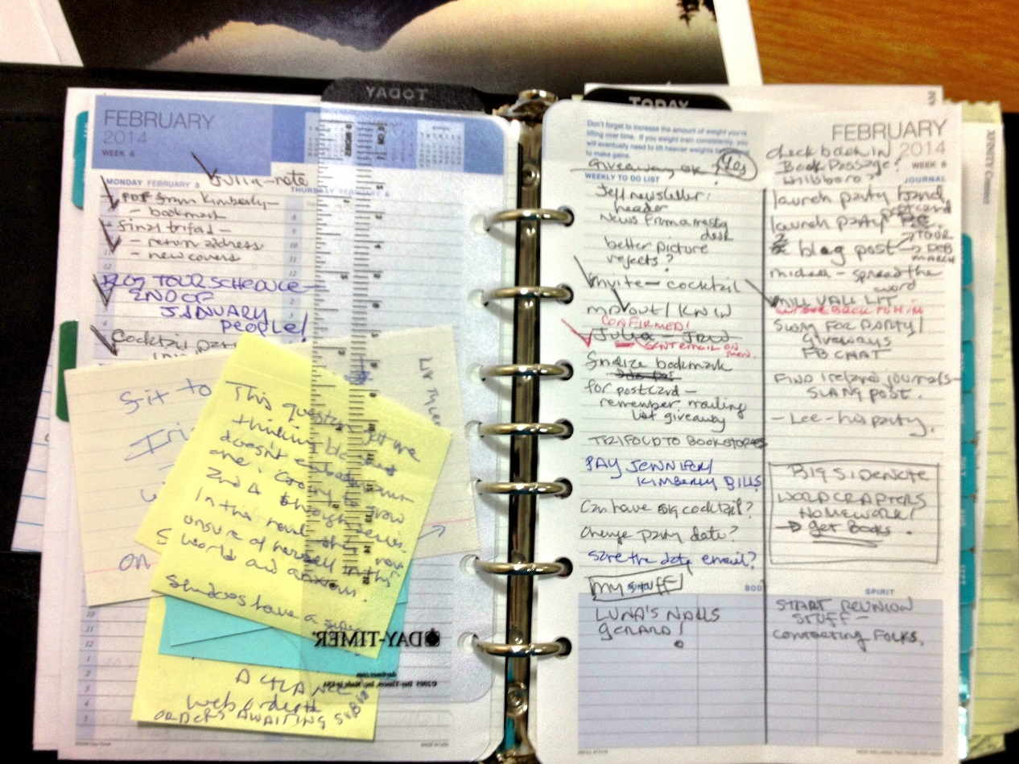
Technology and Counselling It’s not just inevitable, it’s already here

Slide 4
We do have an idea of what’s coming…

Slide 5
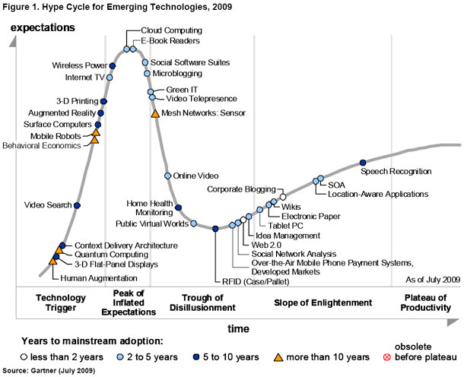
2009

Slide 6
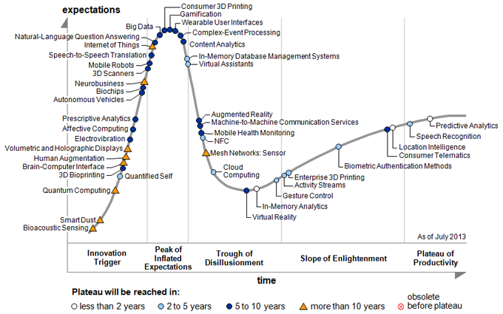
2013

Slide 7
Erikson’s stages and technology (Rempel & Jerry, in progress…)
Stage | Technology Question | Examples
Basic Trust vs. Mistrust | Can I trust the tech to work? | Keeping paper backup, printing emails to store them
Autonomy vs. Shame and Doubt | Can I use the tech without help (most of the time)? | Phone crashes, you get it running again without help
Initiative vs. Guilt | Is it okay to use this tech as much as I’d like to, and is it okay to let it involve more and more of my life/who I am? | Exploring applications to practice
Industry vs. Inferiority | Can I use tech in my life and work in a way that helps me be productive? | Using tech to a point that it becomes transparent to me
Identity vs. Role Confusion | Who am I and what can I be with this tech? | Social relationships and online persona(s), Goffman’s presentation of self stuff

Slide 8
Technology as a Professional Competency
Competence model: Knowledge, Skills, Judgment, Diligence
Can I say that I know the technology that I employ in my practice?
Can I say that I can effectively use the technology I employ in my practice?
Can I say that I use the technology in my practice in a way that is consistent with good clinical/professional judgment as understood in the Code of Ethics and Standards of Practice?
Do I stay up to date with all aspects of my technology? (e.g., software updates, security issues, changes in usage scenarios, etc.)

Slide 9
Interim Conclusions
“Good technology practice is good, ethical counselling practice”
“There will always be some level of risk when using technology”
“We must come to terms with our own comfort with technology”
“View technology in professional practice as an issue of competence”

Slide 10
And remember….
The march of technology is predictable
Our adoption of it is also predicable
It requires our attention in order that we don’t find ourselves in trouble with it

Slide 11
Refs and Bib
WISC-IV and iPad review: http://neuropsychgeek.blogspot.ca/2013/04/wais-and-wisc-on-ipad-good-and-bad.html
Erikson, E. H. (1993). Childhood and society. New York, NY: Norton & Co. (Original work published 1950)
Erikson, E. H. (1994). Identity and the life cycle. New York, NY: Norton & Co. (Original work published 1959)
Erikson, E. H. (with Erikson, J. M.) (1998). The life cycle completed [Extended version]. New York, NY: Norton & Co. (Original work published 1982)

Slide 12
Images references
Daytimer: http://lisaalber.files.wordpress.com/2014/02/daytimer.jpg
iPhone: http://bladebrownshow.com/wp-content/uploads/2014/02/iphone5_ios7_large_verge_medium_landscape.jpg
Gartner: http://www.gartner.com/technology/home.jsp

