Slide 1
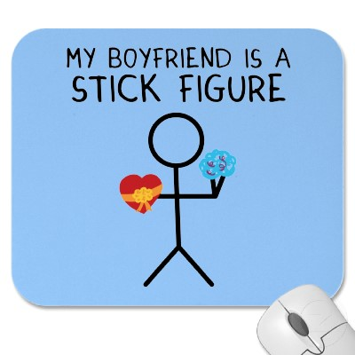
Crayons and Stick-People Exploring sensitive topics with art, stories and other expressive techniques
©2012, Zazzle
Autumn Marie Chilcote, BA, MEd, CCC
autumnchilcote@gmail.com
Notes:
Research supports the use of non-dialogic activities to explore sensitive topics in counselling, with clients enhancing their personal reflections and integrating their experiences through expressive modalities. Furthermore, counsellors and clients engaged in arts-based exploration of sensitive topics report relief from some of the psychological pressure of participating in a sensitive discussion. Despite the benefits of expressive techniques, some practitioners have difficulty introducing and integrating art-based interventions in-session. This interactive presentation and workshop will introduce theoretical foundations and evidence on the effectiveness of expressive techniques in exploring sensitive topic areas such as sexuality, harassment, and violence. Session attendees will have the opportunity to review case examples, navigate language introducing alternate techniques to clients and participate in individual and group practice activities including mapping, letter writing, and drawing, taking away practical tools to integrate into their own reflective practice or counselling setting. (75 minutes)

Slide 2
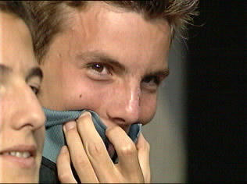
Sensitive Topics
List THREE topics that are sensitive to YOU.
List TWO that may be sensitive to CLIENTS.
©n.d., visualphotos.com
©2001, uci.edu
©2013, Chilcote, A.M.

Slide 3
Sensitive Topics
Art-making
Sex and other bodily functions
God, etc
Social Justice
Money
Body Image
Intelligence
©n.d., sketchfu.com
©2013, Chilcote, A.M.

Slide 4
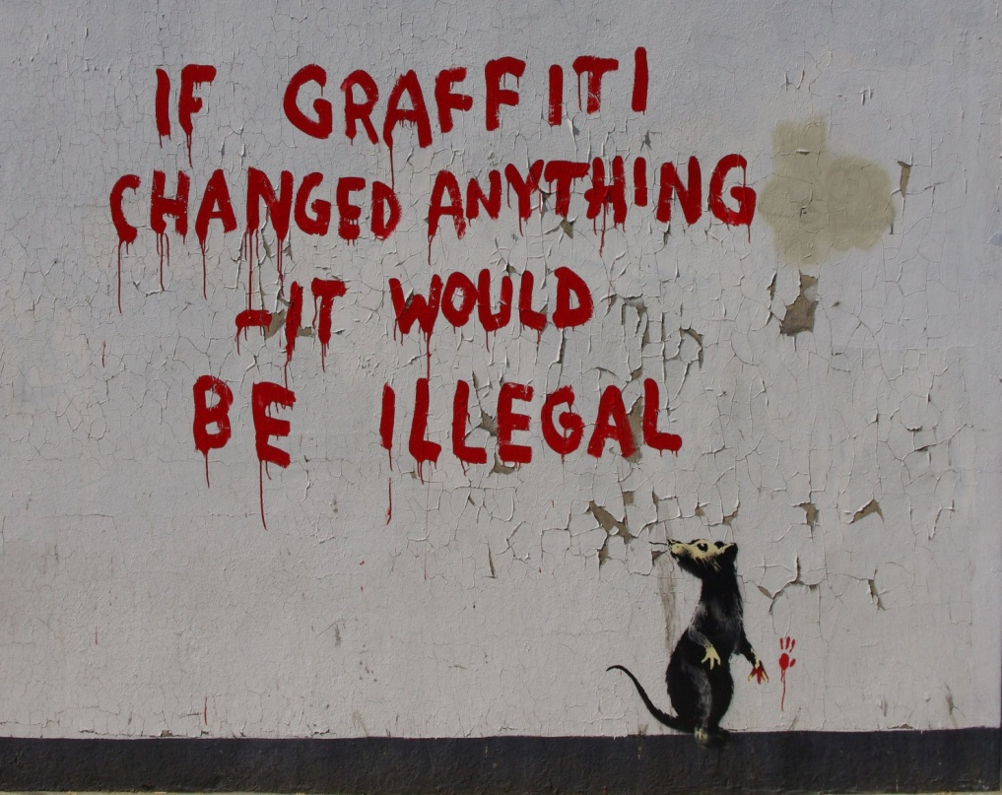
Crayons and Stick People
Topics
Techniques
Materials
Samples
Lots of
practice
©2013, Chilcote, A.M.
©Banksy, 2011

Slide 5
Maps
How do you access sexual health education?
©2001, uci.edu
“I already know all this stuff.”
“I don’t need it.”
“I don’t know.”
©2013, Chilcote, A.M.

Slide 6
Maps
Complexity
Co-existing ideas
Externalizing
Integrating
Sexual health
Abuse
Justice
Safety
©2013, Chilcote, A.M.
Augusta-Scott, 2007; Ludwig, 1997; Pifalo, 2009; Poehnell & Amundson, 2011

Slide 7
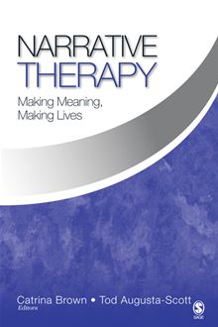
Maps
“I know it’s bad but I don’t know how to stop…”
What would you prefer?
What do you believe is true for others?
©2013, Chilcote, A.M.

Slide 8
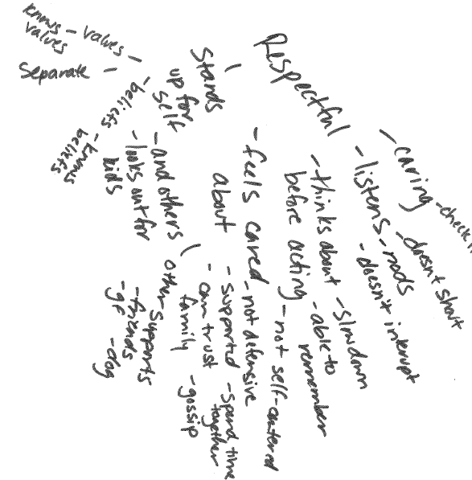
Maps
©2013, Chilcote, A.M.

Slide 9
Maps
Significance
Exceptions
Imagined Future
Spirituality
Substance Misuse
Ethics
Combat Trauma
Topic
©2013, Chilcote, A.M.
Duvall & Beres, 2011; Hagemans et al, 2013

Slide 10
Maps
Embedded
Transactional
Systems
Solutions
Most Distant
Not So Close
Hope
Family
Illness
Justice
Closest Ideas
Me
©2013, Chilcote, A.M.
Duvall & Beres, 2011; Milewski-Hertlein, 2001; Rempel, Neufeld & Kushner, 2007

Slide 11
Workshop!
Choose a map...
How did you get here?
Where are you going?
©2013, Chilcote, A.M.

Slide 12
Make it Yours
MATERIALS
White paper
Pen or pencil
Crayon if desired
ALTERNATES
Maze
Treasure Map
Road Map
©2013, Chilcote, A.M.

Slide 13
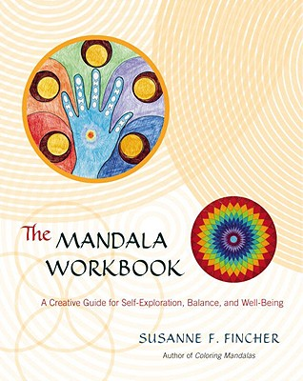
Circles
Order/Disorder
Beliefs
Emotions
FASE/D
Couples
Nursing Philosophy
Trauma
©2013, Chilcote, A.M.
Frame, 2006; Gerteisen, 2008; Henderson et al, 2007; Hwang, 2011; Jung, 1964; Marshall, 2003

Slide 14
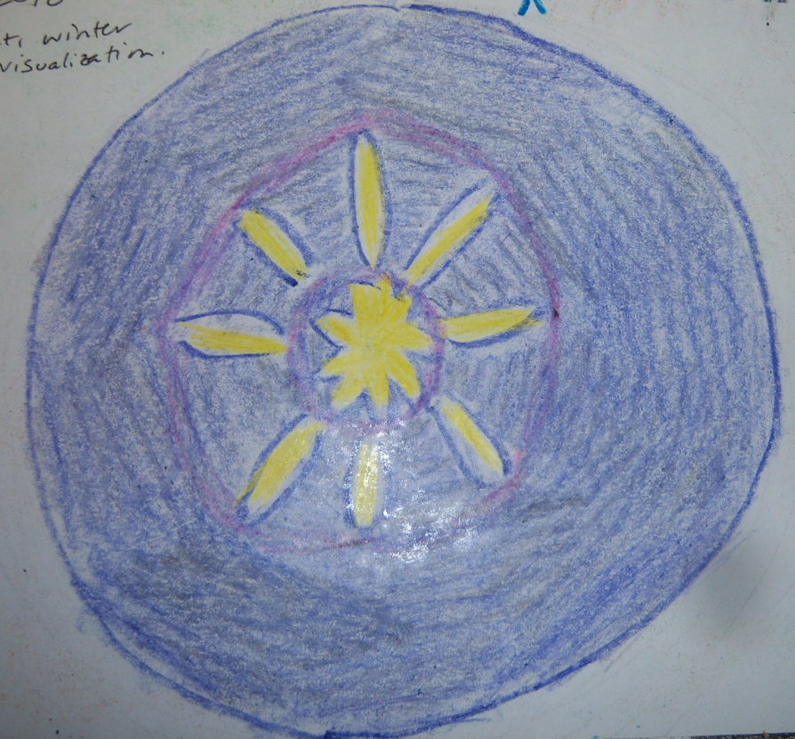
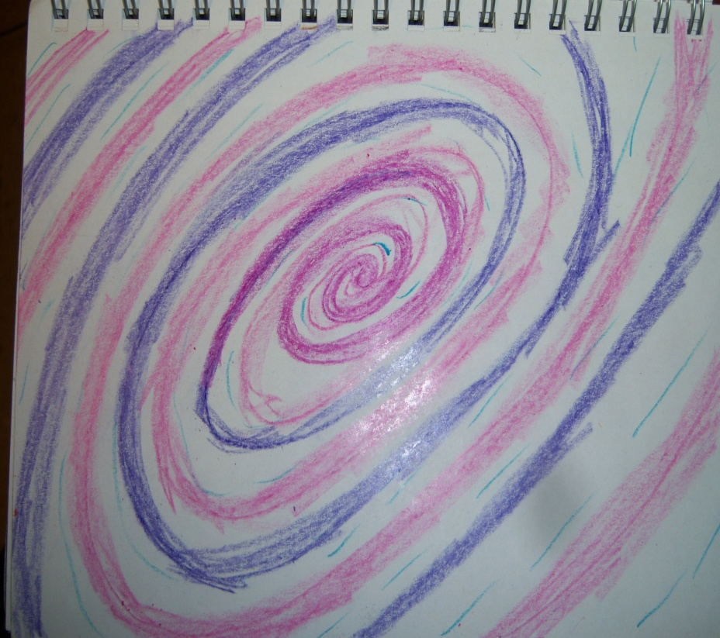
Circles
Physiology
Focus
Relief
Motivation
©2013, Chilcote, A.M.
Anderson, 2002; Schrade, Tronsky & Kaiser, 2011; van der Vennet & Serice, 2012

Slide 15
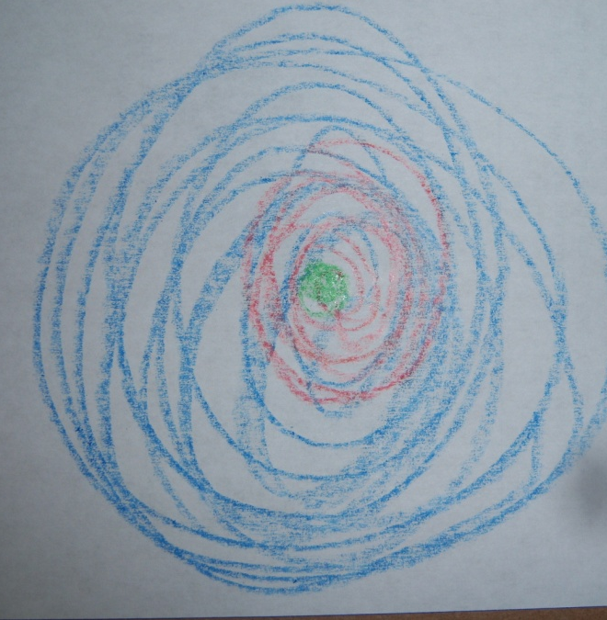
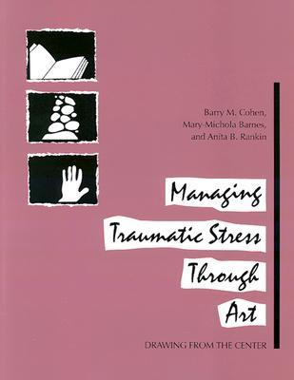
Workshop!
Focus on your breath.
Start from the centre, spiral outward.
Exhale deeply, inhale and spiral outward.
Exhale deeply, inhale, spiral outward and hold to the outer edges of the page…
©2013, Chilcote, A.M.

Slide 16
Make it Yours
MATERIALS
Paper
Pen or pencil
Crayon if desired
Forms?
ALTERNATES
Centre Point
Pie Pieces
Outside→ In
Outside Only
Printable Forms
©2013, Chilcote, A.M.

Slide 17
Stories & Poems
“Symbolic mediator”
Identity
Emotion & Self-soothing
Sobriety & Substance Use
Self-harm
Chronic Illness & Death
Stepfamilies
©2013, Chilcote, A.M.
Adamo et al, 2008; Chapadjiev, 2008; Church, 1999; Hinz, 2006

Slide 18
Stories & Poems
FAIRY TALES
Good Character
Bad Character
Magic
Happy Ending
SHORT SHORTS
One Sentence
Three Sentence
Prompts
Characterizations
©2013, Chilcote, A.M.

Slide 19
Workshop!
Write from the perspective of your “pet parrot.” How would s/he describe you?
One strength
One weakness
We get along when…
When we fight, we make up by…
MATERIALS
Paper
Pen or pencil
Prompts (optional)
©2013, Chilcote, A.M.

Slide 20
Letter Writing
Relational Skills
Emotional Attendance
Self- Analysis
Biology
ALTERNATES
Three Sentences
Past/ Future
Grandchild
©2013, Chilcote, A.M.

Slide 21
Practical Scientists
“A practice-oriented introduction to building an evidence base for counselling and psychotherapy”
“Practice-based evidence in school-based counselling”
“Evaluating the processes and outcomes of vocational counselling”
©2013, Chilcote, A.M.
Hanley, Sefi & Lennie, 2011; Henton, 2012; Hiebert et al, 2011; Young, 2009

Slide 22
Make it Yours
MATERIALS
File review
Progress/Outcomes
SurveyGizmo?
©2013, Chilcote, A.M.

Slide 23
Stick People, Body Parts
Positioning
Development
Communication
Interpretation
Sexuality
History
Violence
Cancer
Supervision
©2013, Chilcote, A.M.
Brown, 1986; Buchalter, 2004; Chilcote, 2011; Wright, 2007

Slide 24
Workshop!
What mood is your THUMB currently in?
Trace your thumb.
Fill it in however you like.
Fill in the surroundings if you like.
MATERIALS
Paper
Crayons
©2013, Chilcote, A.M.

Slide 25
Challenges
Time Management
Reflection
Humour
Motivation
Bring your Best Self
Autumn M Chilcote, BA, MEd, CCC
autumnchilcote@gmail.com
©2013, Chilcote, A.M.

Slide 26
References
Adamo, S. et al (2008). Tom Thumb in hospital: The fairy tale workshop in a paediatric oncology and haematology ward. Psychodynamic Practice, 14(3), 263-280.
Anderson, T. (2002). Mandala: Constructing peace through art. Art Education, 55, 33-39.
Aronoff, D. & McCormick, N. (1990). Sex, sex role identification and college students’ projective drawings. Journal of Clinical Psychology, 46, 460-466.
Augusta-Scott, T. (2003). Dichotomies in the power and control story: Exploring multiple stories about men who choose abuse in intimate relationships. In Responding to violence: A collection of papers relating to child sexual abuse and violence in intimate relationships, pp 204-224. Adelaide: Dulwich Centre Publications
Augusta-Scott, T. (2007). Letters from prison: Re-authoring identity with men who have perpetrated sexual violence. In Narrative Therapy: Making Meaning, Making Lives. Toronto: Sage.
Berends, L. (2011). Embracing the visual: Using timelines with in-depth interviews on substance use and treatment. The Qualitative Report, 16(1), 1-9.
Brown, V.H. (1986). The integration of self-identity and self-esteem through curriculu developent. Chicago: Native American Educational Services.
Buchalter, S. (2004). A Practical Art Therapy. London: Kinglsey.
Chapadijev, S. Ed.) (2008). Live Through This: On creativity and self-destruction.
Church, E. (1999). The poisoned apple: Stepmothers’ experience of envy and jealousy. Journal of Feminist Family Therapy, 11(3), 1-18.
Cohen, B., Barnes, M. & Rankin, A. (1995). Managing Traumatic Stress Through Art. NY: Sidran.
Curry, J. (2009). Examining client spiritual history and the construction of meaning: The use of spiritual timelines in counseling. Journal of Creativity in Mental Health, 4(2), 113-123.
Duffey, T. (date?) Creative Interventions in Grief and Loss Therapy. Publisher?
Duvall, J. & Beres, L. (2011). Innovations in Narrative Therapy. NY: Norton.
Frame, P.G. (2006). Assessing a couple’s relationship and compatibility using the MARI Card Test and Mandala Drawings. Art Therapy, 23(1), 23-29.
Gerteisen, J. (2008). Monsters, monkeys & mandalas: Art therapy with children experiencing the effects of trauma and fetal alcohol spectrum disorder. Art Therapy, 25, 90-93.
©2013, Chilcote, A.M.

Slide 27
References
Hagemans, M. van der Maij, H., de Jong, T. (2013). The effects of a concept map-based support tool on simulation-based inquiry learning. Journal of Educational Psychology, 105, 1-24.
Hanley, T., Sefi, A. & Lennie, C. (2011). Practice-based evidence in school-based counselling. Counselling & Psychotherapy Research, 11, 300-309.
Henderson, P., Rosen, D. & Mascaro, N. (2007). Empirical study on the healing nature of mandalas. Psychology of Aesthetics, Creativity and the Arts, 1(3), 148-154.
Henton, I. (2012). Practice-based research and counselling psychology: A critical review and proposal. Counselling Psychology Review, 27. 11-28.
Hiebert, B., Domene, J. & Buchanan, M. (2011). The power of multiple methods and evidence sources: Raising the profile of Canadian counselling psychology research. Canadian Psychology, 52, 265-275.
Hinz, L. (2006). Drawing from Within: Using art to treat eating disorders. London: Kingsley.
Ho, R. et al (2010). Changes in breast cancer patients after psychosocial interventions as indicated in drawings. Psycho- Oncology, 19(4), 353-360.
Hwang, K. (2011). The mandala model of self. Psychological Studies, 56(4), 329-334.
Jung, C. (1964). Man and his symbols. NY: Dell Pub Co.
Ludwig, S. (1997). Abused women’s experience wit the justice system: Concept mapping. Dissertation Abstracts I nternational: Humanities and social Sciences, 58(5-A), 1602.
Lowenstein, L. (n.d.) Original Therapeutic Resources for Mental Health Practitioners and Families. www.lianalowenstein.com
Ludwig, S. (1997). Abused women’s experience wit the justice system: Concept mapping. Dissertation Abstracts International: Humanities and social Sciences, 58(5-A), 1602.
Marshall, M. (2003). Creative learning: The mandala as a teaching exxercise. Journal of Nursing Education, 42, 517-520.
McLeod, J. & Elliott, R. (2011). Systematic case study research: A practice-oriented introduction to building an evidence base for counselling and psychotherapy. Counselling & Psychotherapy Research, 11(1), 1-10.
Milewski-Hertlein, K. (2001). The use of a socially constructed genogram in clinical practice. American Journal of Family Therapy, 29, 23-38.
©2013, Chilcote, A.M.

Slide 28
References
Pifalo, T. (2009). Mapping the maze. Journal of the American Art Therapy Association, 26(1), 12-18.
Poehnell, G. & Amundson, N. (2008). Hope-Filled Engagement. Vancouver: Ergon.
Presbury, J. Echterling, L., & Mckee, J. (2008). Beyond brief counseling and therapy: An integrative approach. NJ: Pearson.
Rabaia, Y., Nguvetv, V., Giacaman, R. (2011). The Gaza Diamond: Drawings and wishes of Palestinian teenagers. International Journal of Mental Health, 9, 44-52.
Rempel, G., Neufeld, A. & Kushner, K. (2007). Interactive use of genograms and ecomaps in family caregiving research. Journal of Family Nursing, 13, 403-421.
Schrade, C., Tronsky, L. & Kaiser, D. (2011). Physiological effets of mandala making in adults with intellectual disabilities. Arts in Psychotherapy, 39(2), 109-113.
Schwednimann, B. (2011). Mapping biological ideas: Concept maps as knowledge integration tools for evolution
education. University of California: Berkeley.
Simmons, C. & Rycraft, J.R. (2010). Ethical challenges of military social workers serving in a combat zone. Social Work, 55, 9-18.
Stone, D. & Amundson, N. (1989). Counsellor supervision: An exploratory study of the metaphoric case drawing method of case presentation in a clinical setting. Canadian Journal of Counselling, 23, 360-371.
Sunday Scribblings. (2013). Sunday Scribblings. www.sundayscribblings.blogspot.ca
Valadez A. & Evans, M. (2005). A Novel Approach: Using literary writing and creative interventions for working toward forgiveness after relationship dissolution and divorce. Journal of Creativity in Mental Health, 1, 103-121.
Van der Vennet, R. & Serice, S. (2012). Can coloring mandalas reduce anxiety? A replication study. Art Therapy, 29(2), 87- 92.
Wright, S. (2007). Meaning-making through drawing and telling. Australian Journal of Early Childhood, 32, 37-48.
Young, R. (2009). Evaluating the processes and outcomes of vocational counselling: An action theory perspetive. Orientation Scolaire et Professionnelle, 38(3), 281-306.
©2013, Chilcote, A.M.

